Slide 1
Innovative Projects Using Raspberry Pi (ECE2011) Phase –I Review Presentation (26th Sept to 27th Sept 2024) SMART READER FOR VISUALLY IMPAIRED PEOPLE
By
IPR-276
Under the supervision of Department of Xxxxxxxx Engineering Under the supervision of
DR. Somashekar
Department of ECE
Name | Roll Number
Arigela Poojitha Ariveni | 20231CSG0006
Srushti Sarah | 20231EVT0019
Sharadha S R | 20231CSG0171
Pavani V | 20231CCS0121
Avinash | 20231CCS0126
Akanksha B A | 20231CSD0107

Slide 2
SMART READER FOR VISUALLY IMPAIRED PEOPLE
PROBLEM STATEMENT DESCRIPTION:
A smart reader is a revolutionary assistive technology designed to empower visually impaired individuals by providing access to written information.
Equipped with advanced optical character recognition (OCR) and text-to-speech capabilities, this device transforms printed text into audible speech, allowing users to independently consume books, documents, and labels
A smart reader is a valuable tool that empowers visually impaired individuals to lead more independent and fulfilling lives by breaking down barriers to information access.

Slide 3
INNOVATION:
Real-time OCR and Text-to-Speech: The device will utilize advanced OCR technology to accurately recognize text from various surfaces, including low-contrast or unevenly printed materials. The text-to-speech feature will provide immediate audio feedback, ensuring a seamless reading experience.
UNIQUENESS:
Hybrid Approach: The smart reader will combine the strengths of traditional OCR technology with advanced image recognition and AI techniques to provide a more comprehensive and accurate reading experience.
Real-time Adaptation: The device will be capable of adapting to different lighting conditions, text sizes, and document types, ensuring optimal performance in various environments.
Natural Language Processing: By incorporating natural language processing capabilities, the smart reader can provide contextually relevant information and explanations, making the reading experience more engaging and informative.
User-Centric Design: The device will be designed with the specific needs and preferences of visually impaired individuals in mind, ensuring a comfortable and intuitive user experience.

Slide 4
Technical Approach:
Hardware specifications:
Raspberry pi 3
Speaker
USB Camera
LCD Display
Push Buttons
Transformers/Adapters
Cables and Connectors
Software specifications:
Python 3 Compiler
Programming language : Python

Slide 5
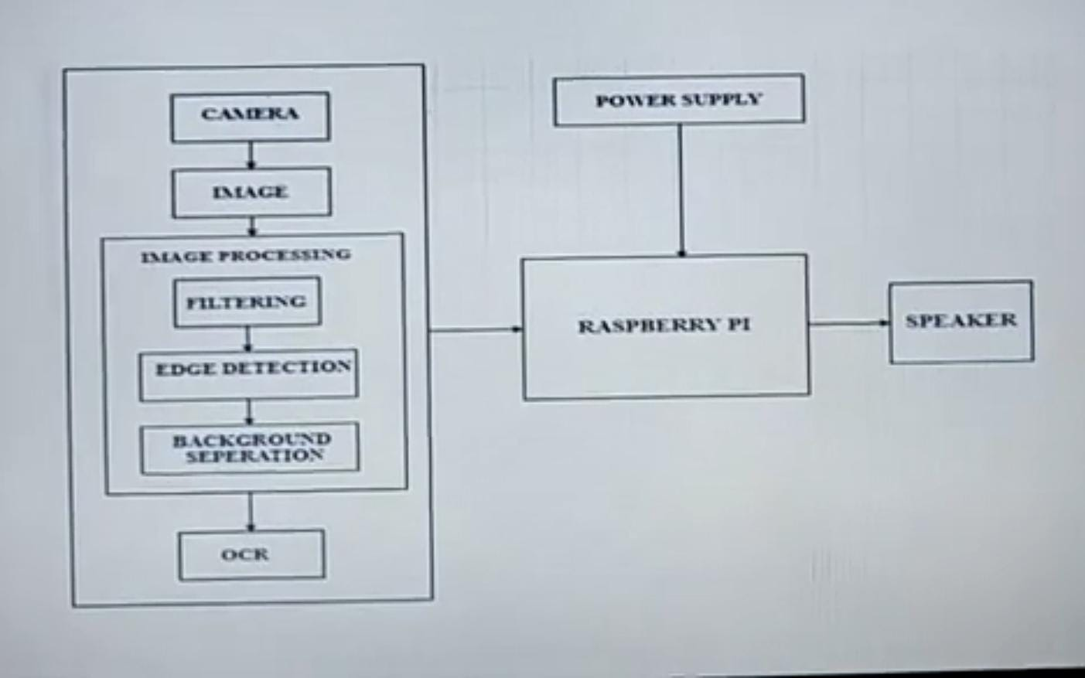
Flow Diagram - proposed system:
User picks up a printed document or object.
Device camera captures image of the text or object.
OCR technology processes the captured image.
Text is extracted and converted into digital format.
Text-to-speech engine converts digital text into audio.
Audio output is delivered through headphones or speakers.
User listens to the spoken text.User can adjust speech rate, volume, or voice settings.
User can request additional information or context.

Slide 6
Impacts and Benefits
Social impacts:
Increased Independence
Reduced Social Isolation
Educational impacts:
Enhanced Access to Education
Economic impacts:
Increased Employment Opportunities

Slide 7
Project Timeline:
Phase 1
Phase 2
*Finalize hardware and software design
*integrate OCR,text –to-speech and image recognition components
Phase 3
*Field testing
*Data anaylysis
*final presentation and documentataion
*Literature
Review and technology
*Requirements gathering
*Project planning

Slide 8
Q&A

Slide 9
Thank you !!

